Slide 1

Siddaganga Institute of Technology, Tumakuru-3
(An autonomous institution affiliated to VTU, Belagavi)
2024-25
Department of Computer Science
Title: Secured Examination System
Batch id:B21
Under the Guidance of :
Dr T. M. Kiran Kumar
Assistant Professor

Slide 2
Introduction
Problem Statement
Despite the widespread integration of digital tools in education, examination systems in many academic institutions continue to depend on outdated, manual processes that are vulnerable to a range of security threats. Issues such as question paper leaks, unauthorized access, and result manipulation compromise the credibility and integrity of assessments. With the growing demand for remote and online education, there is an urgent need for a secure, scalable, and fully online examination system. Current solutions often lack robust mechanisms to ensure data integrity, secure user authentication, and efficient exam management. Therefore, there is a critical need for a modern, technology-driven examination platform that guarantees confidentiality and authenticity throughout the assessment lifecycle.
Proposed Solution
A secure, blockchain similar online exam platform focused on MCQs, utilizing encrypted question paper distribution.
Technology Stack
Built with React.js, Node.js, Express.js, and MongoDB. Uses JWT and bcrypt for authentication, and stores encrypted exam data and results on blockchain like structure to prevent tampering.

Slide 3
Literature Survey
S.no | Title of the Article | Published Year | Author, Published by | Objectives | Gap Identified
1 | Blockchain-based Competitive Examination System in India: Preventing Paper Leaks and Mitigating Frauds | 2024 | Anush D Kamble, Deepak A Kamble; IJIRSET | Proposes blockchain-based solution to prevent question paper leaks, cheating, and fraud in Indian exams. Ensures transparency, result authenticity, and tamper-proof records using cryptography and smart contracts. | Focuses mainly on conceptual blockchain model; lacks real-world deployment, scalability, and integration challenges with existing education boards.
2 | A Proposed Model for Improving the Reliability of Online Exam Results Using Blockchain | 2023 | Mohamed Abdelsalam, Marwan Shokry, Amira M. Idrees; IEEE Access | Integrates blockchain with Moodle LMS using Ethereum smart contracts and MetaMask for tamper-proof exam data. Enhances transparency and trust in results.. | Limited to Moodle integration; does not fully address large-scale exam ecosystems or offline/low-bandwidth scenarios

Slide 4
Literature Survey
S.no | Title of the Article | Published Year | Author, Published by | Objectives | Gap Identified
3 | An Advanced and Secure Framework for Conducting Online Examination Using Blockchain Method | 2023 | Md Rahat Ibne Sattar, Md. Thowhid Bin Hossain Efty, Taiyaba Shadaka Rafa, Tusar Das, Md Sharif Samad, Abhijit Pathak, Mayeen Uddin Khandaker, Md. Habib Ullah; Elsevier B.V. (KeAi Communications) | Combines blockchain, AI, and RDP for identity fraud prevention and cheating detection (face recognition, noise detection, 360° monitoring, plagiarism checks). Stores results immutably on blockchain. | Internet dependency, privacy concerns, and high implementation cost make adoption difficult in developing regions..
4 | Smart Contract Enabled Online Examination System Based in Blockchain Network | 2021 | Mr. Apoorv Jain, Dr. Arun Kumar Tripathi, Naresh Chandra, P. Chinnasamy; IEEE (ICCCI) | Ethereum-based exam system with smart contracts ensuring secure registration, MetaMask payments, and data transfer. Uses Proof-of-Stake consensus for tamper-proof records.. | Focuses on Ethereum only; scalability, transaction fees, and usability challenges not fully addressed

Slide 5
Literature Survey
S.no | Title of the Article | Published Year | Author, Published by | Objectives | Gap Identified
5 | Secure Online Examination with Biometric Authentication and Blockchain-Based Framework (SEBB) | 2021 | Xiaoling Zhu, Chenglong Cao; Hindawi (Mathematical Problems in Engineering) | Integrates biometric authentication with blockchain using fuzzy vault, attribute-based encryption, and consortium blockchain for exam integrity and dispute resolution. | Limited to biometric focus; practical deployment issues like privacy risks and infrastructure needs not fully resolved.
6 | A Blockchain-based File-sharing System for Academic Paper Review | 2020 | Ian Zhou, Imran Makhdoom, Mehran Abolhasan, Justin Lipman, Negin Shariati; IEEE | Proposes blockchain-based double-blind peer-review using Hyperledger Fabric + IPFS. Introduces “AcadCoin” for incentivizing reviewers and ensures transparency in publishing. | Not directly exam-focused; limited scope to academic publishing and peer review.

Slide 6
Literature Survey
S.no | Title of the Article | Published Year | Author, Published by | Objectives | Gap Identified
7 | Online Test and Management System Using Blockchain Network | 2019 | Seung Jae Pee, Eung Seon Kang, Jae Geun Song, Ju Wook Jang; ICACT | Blockchain-based online exam system ensuring data integrity, confidentiality, and role-based access control (CP-ABE). Uses smart contracts for grading and prevents tampering. | Early-stage model; lacks advanced monitoring (AI/biometrics) and does not consider scalability for mass adoption.

Slide 7
Objectives
1. Local Encrypted Chunk Storage, Increase the security of exam content by dividing each question paper into multiple encrypted chunks and storing them locally instead of using external blockchain storage like Ethereum.
2. Designing a robust system that supports online mode of examination, ensuring flexibility and accessibility.
3.Tamper-proof approach to question paper management that safeguards against unauthorized access and potential leaks.
4. Providing a user-friendly interface for teachers, administrators, and students.

Slide 8
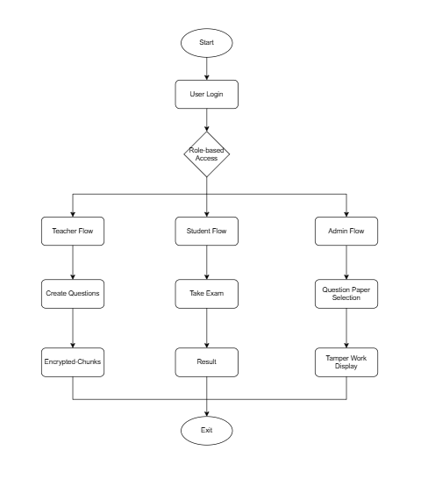
Design Framework

Slide 9
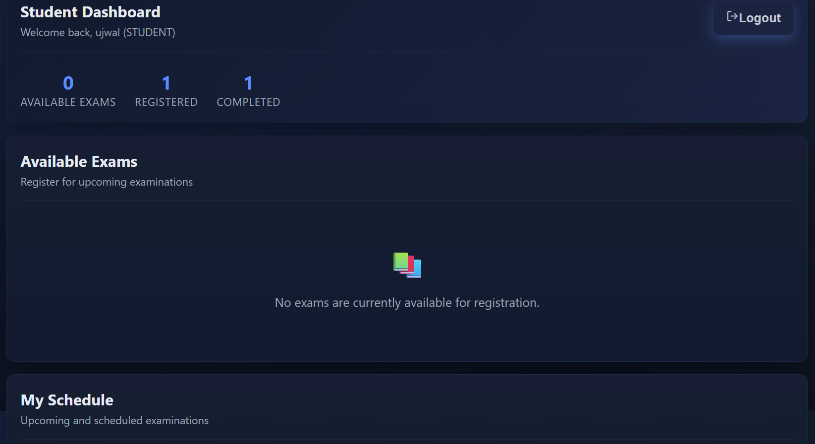
Implemented Module

Slide 10
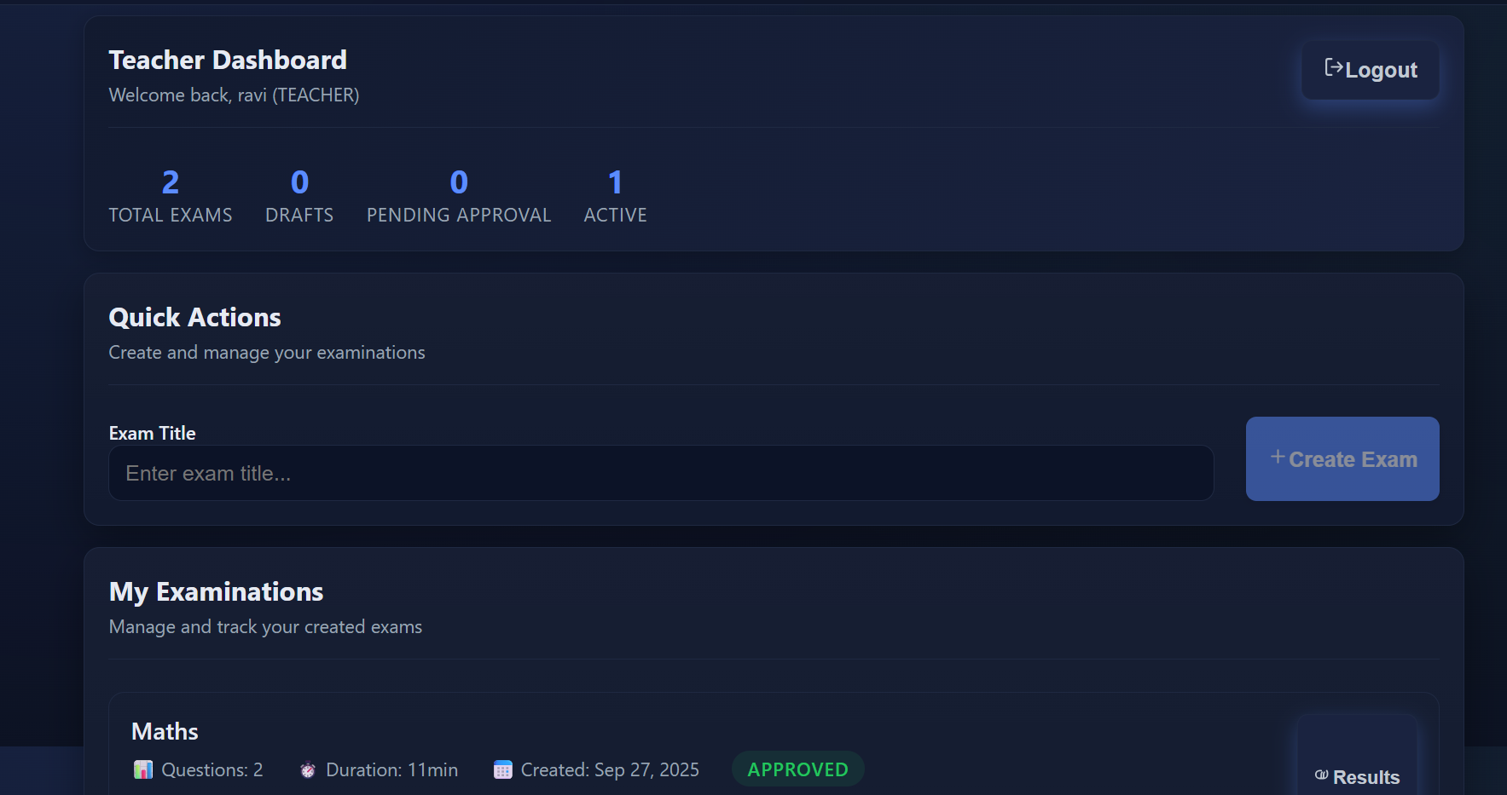

Slide 11
Expected Outcomes
Secure Exam Management – Exams stored as encrypted blockchain chunks, ensuring no unauthorized tampering.
Confidentiality – Questions remain hidden even if the database is compromised, due to AES-256-CBC encryption.
Transparent Monitoring –Tracking of registrations, exam progress, and results through the database manager.
Fair Evaluation – Automatic validation and grading system ensures fairness for all students
User Role Management – Admin, Teacher, and Student roles clearly separated, ensuring controlled access.
Scalability – Chunking mechanism allows large exams to be securely stored and processed without performance issues.

Slide 12
Conclusion
The project demonstrates how blockchain-inspired security principles can revolutionize online examinations. By combining encryption, hashing, and chaining, we ensure exam data is both secure and tamper-proof. Unlike traditional exam systems, this solution guarantees confidentiality, integrity, and authenticity from exam creation to result publication.

